Slide 1
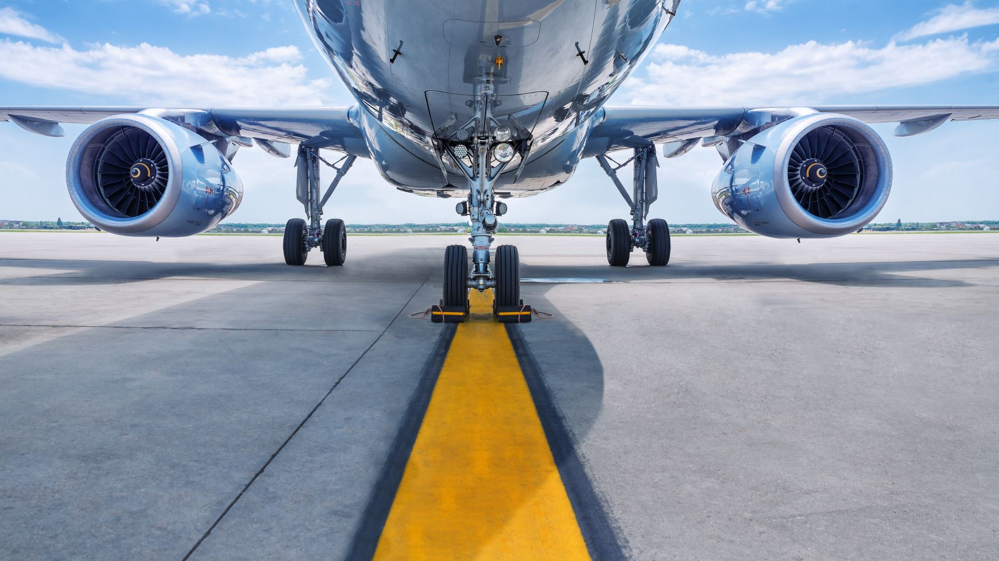
‘COME FLY WITH ME!’; Analyzing Airline Safety Statistics against Automobile Safety
By Osmond C. Oke

Slide 2
Problem
As you are all aware, we are currently being faced with claims by the media stating that airline travel is no longer the safer route to take, in comparison with Automobile travel. The metrics outlined in the internal dashboard were just a start; here, my goal is to provide accurate comparisons, more numbers oriented that the dashboard.

Slide 3
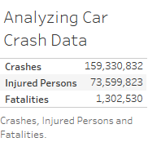
Metric 1

Slide 4
Metric 1
The metric shows :
Crashes (C) = 159,330,832
Injured Persons (I) = 73,599,823
Fatalities (F) =1,302,530
Injured Persons Per Crash = I/F = 0.46
Fatalities per Crash = F/C = 0.008

Slide 5
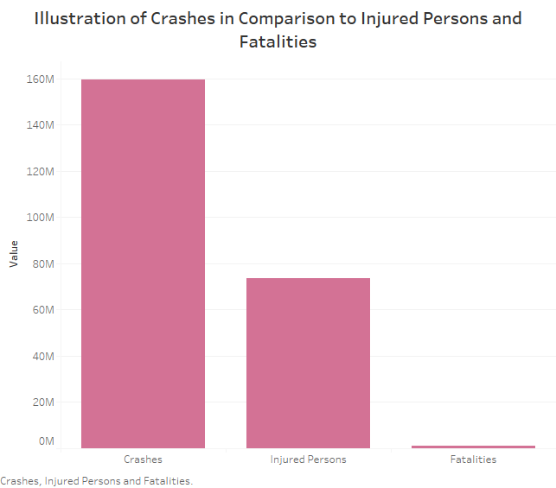
Metric 2

Slide 6
Metric 2
We can see the very high number of Car Crashes, surpassing 150 million incidents.
We can see the very high number injured people, surpassing 73 million incidents.
We can see the very high number of fatalities, surpassing 1.3 million incidents.

Slide 7
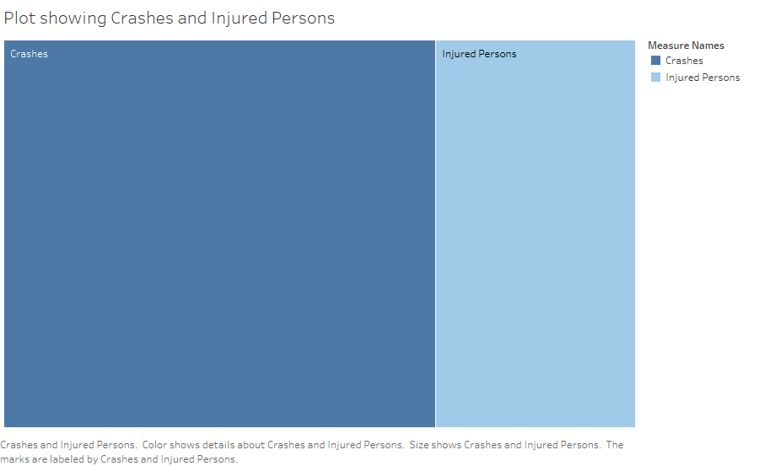
Comparing Auto Crashes to Injured Persons
159,330,832
73,599,823
Injured Persons Per Crash = I/F = 0.46
Fatalities per Crash = F/C = 0.008

Slide 8
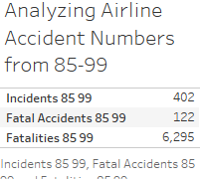
Metric 3

Slide 9
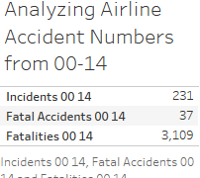
Metric 4

Slide 10
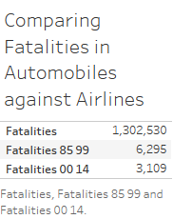
Metric 5

Slide 11
Metrics 3, 4 & 5
From these metrics, we can see how low the Fatalities of the Airline accidents are, in comparison to those from the automobile accidents.

Slide 12
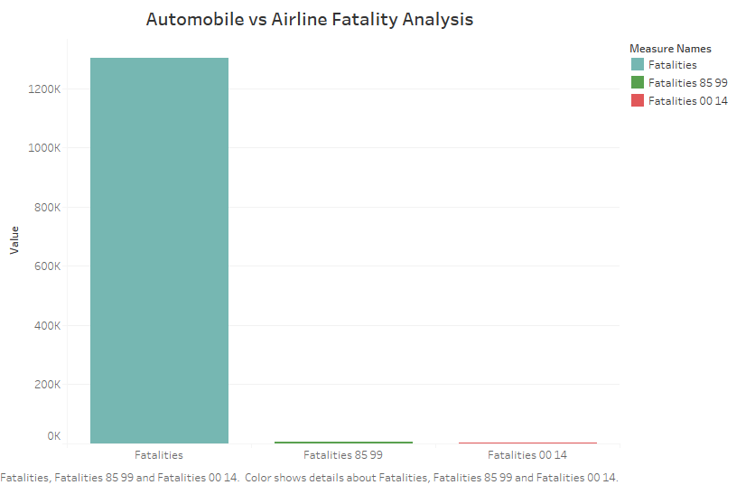
Metric 6

Slide 13
Observations
From Metrics 3 and 4, We can see that there is a drastic fall in the number of Incidents, Fatal Accidents and Fatalities, from the 85-99 Year group to the 00-14 Year Group.
This can be seen as a clear indication of an improvement in flying safety conditions, as opposed to the narrative the media is attempting to push.

